Slide 1
Mamba
Linear-Time Sequence Modeling with Selective State Spaces
Albert Gu, Tri Dao
2024 COLM Outstanding Paper
https://arxiv.org/abs/2312.00752
李奇軒, 2025/08/19
Notes:
COLM（Conference on Language Modeling）

Slide 2
Agenda
Sequence Models
HiPPO
S4
Mamba
Performance

Slide 3
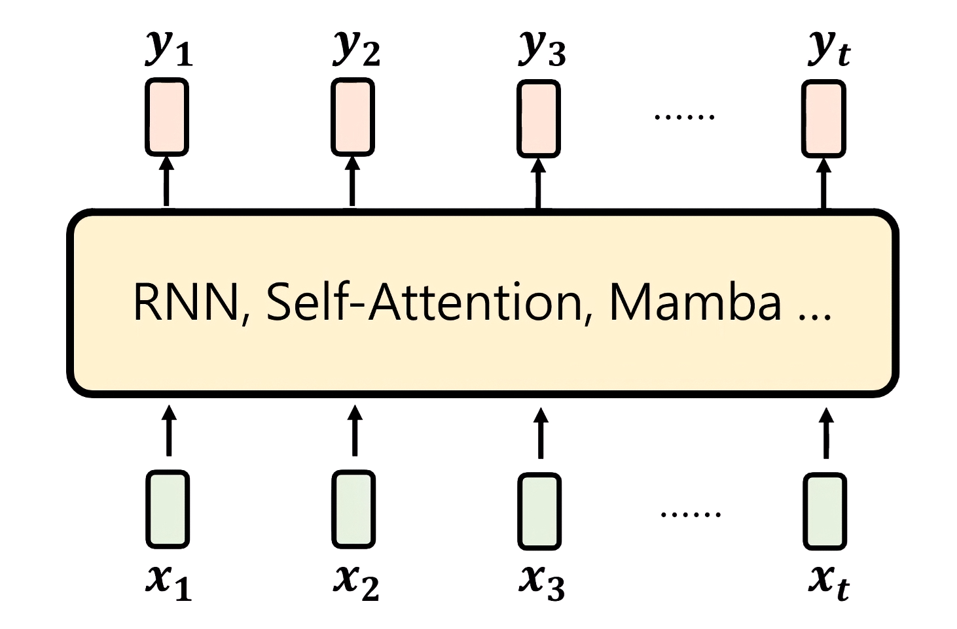
Sequence Models – 要解決什麼問題
給一個Sequence X, <x1,x2,x3,…,xt>
Output Sequence Y, <y1,y2,y3,…,yt>
你
好
!
<bos>
你
好
https://youtu.be/gjsdVi90yQo

Slide 4
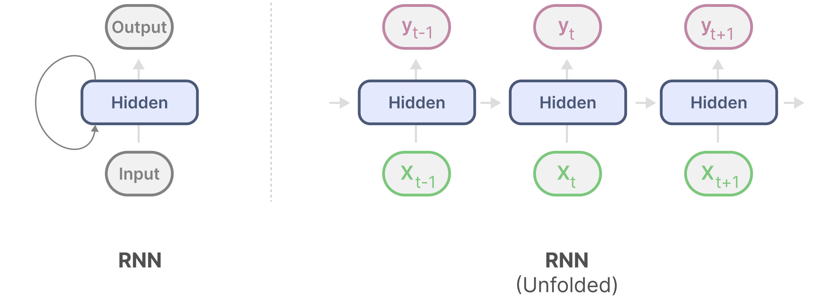
Sequence Models – RNN
RNN 具有循環機制，將資訊從上一步傳遞到下一步
loop
https://newsletter.maartengrootendorst.com/p/a-visual-guide-to-mamba-and-state

Slide 5
Sequence Models – RNN
RNN 具有循環機制，將資訊從上一步傳遞到下一步
loop
https://newsletter.maartengrootendorst.com/p/a-visual-guide-to-mamba-and-state

Slide 6
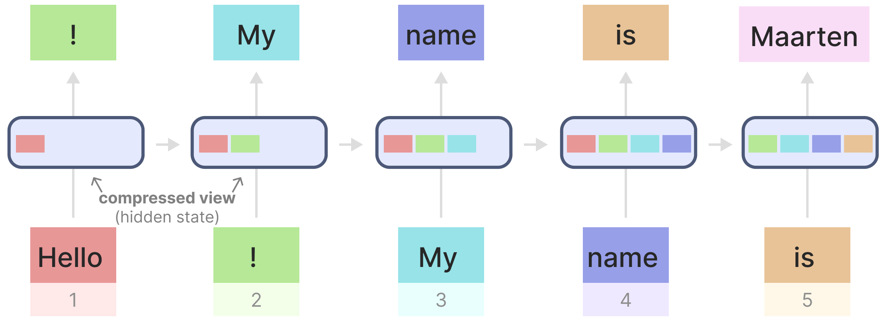
Sequence Models – RNN
過往資訊壓縮在Hidden State裡面
Strengths: Inference計算量小
Weaknesses: Training慢(Hidden State有相依性)、容易遺忘
hidden
遺忘 Hello
https://newsletter.maartengrootendorst.com/p/a-visual-guide-to-mamba-and-state

Slide 7
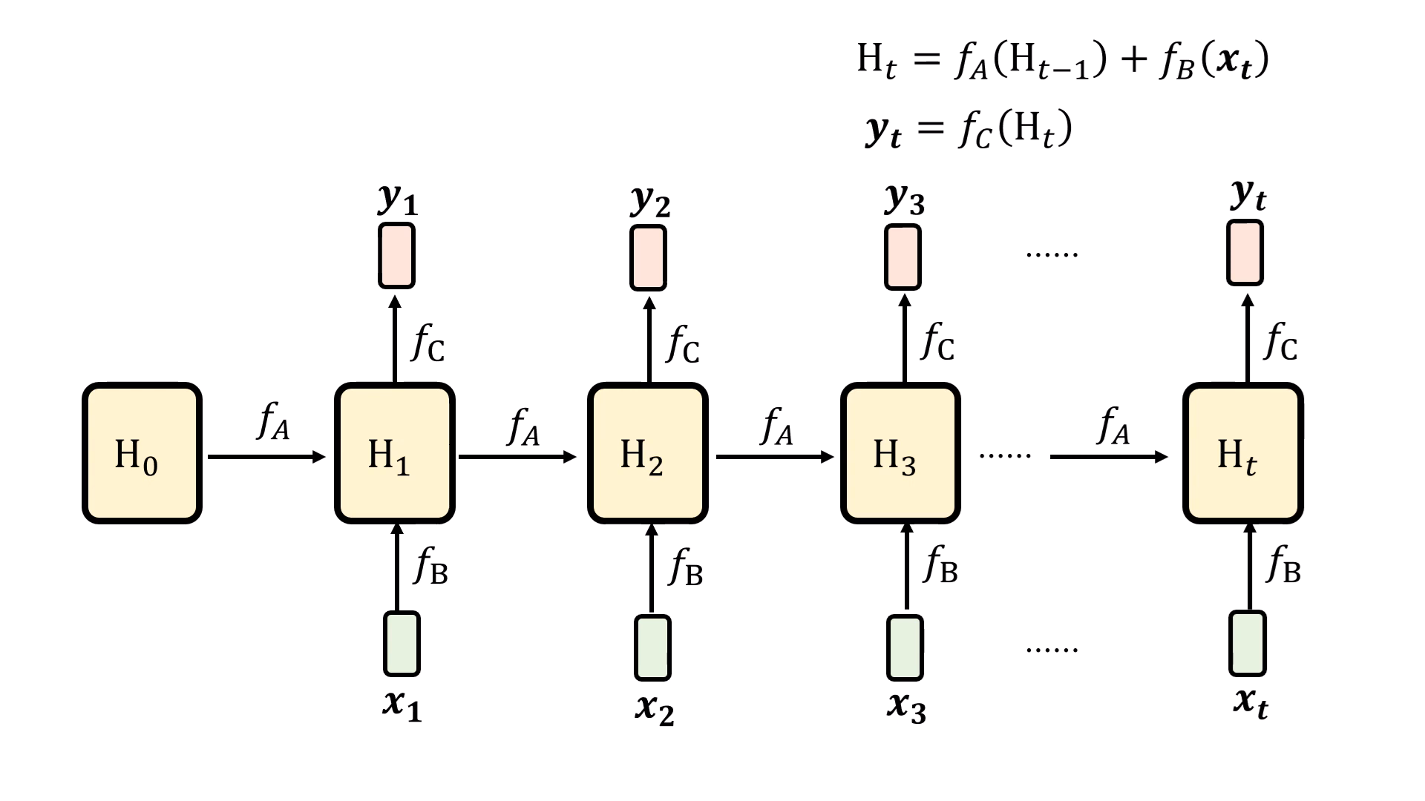
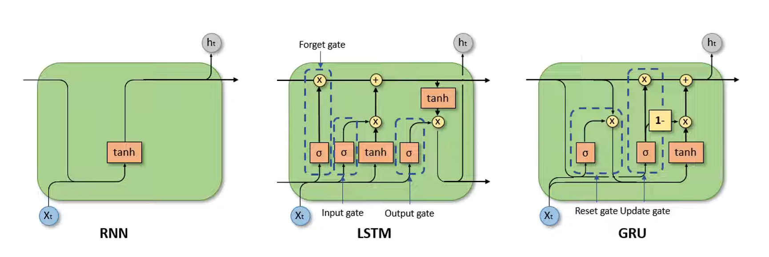
Sequence Models – LSTM & GRU
加入Gate機制，控制更新、輸入、輸出…
fa
fb
fc

Slide 8
Sequence Models
 | Training Phase | Inference Phase | Information | Issue
RNN (1986) | slow | fast | rapid forgetting | 梯度爆炸/消失
LSTM (1997) | slow | fast | forgetting

Slide 9
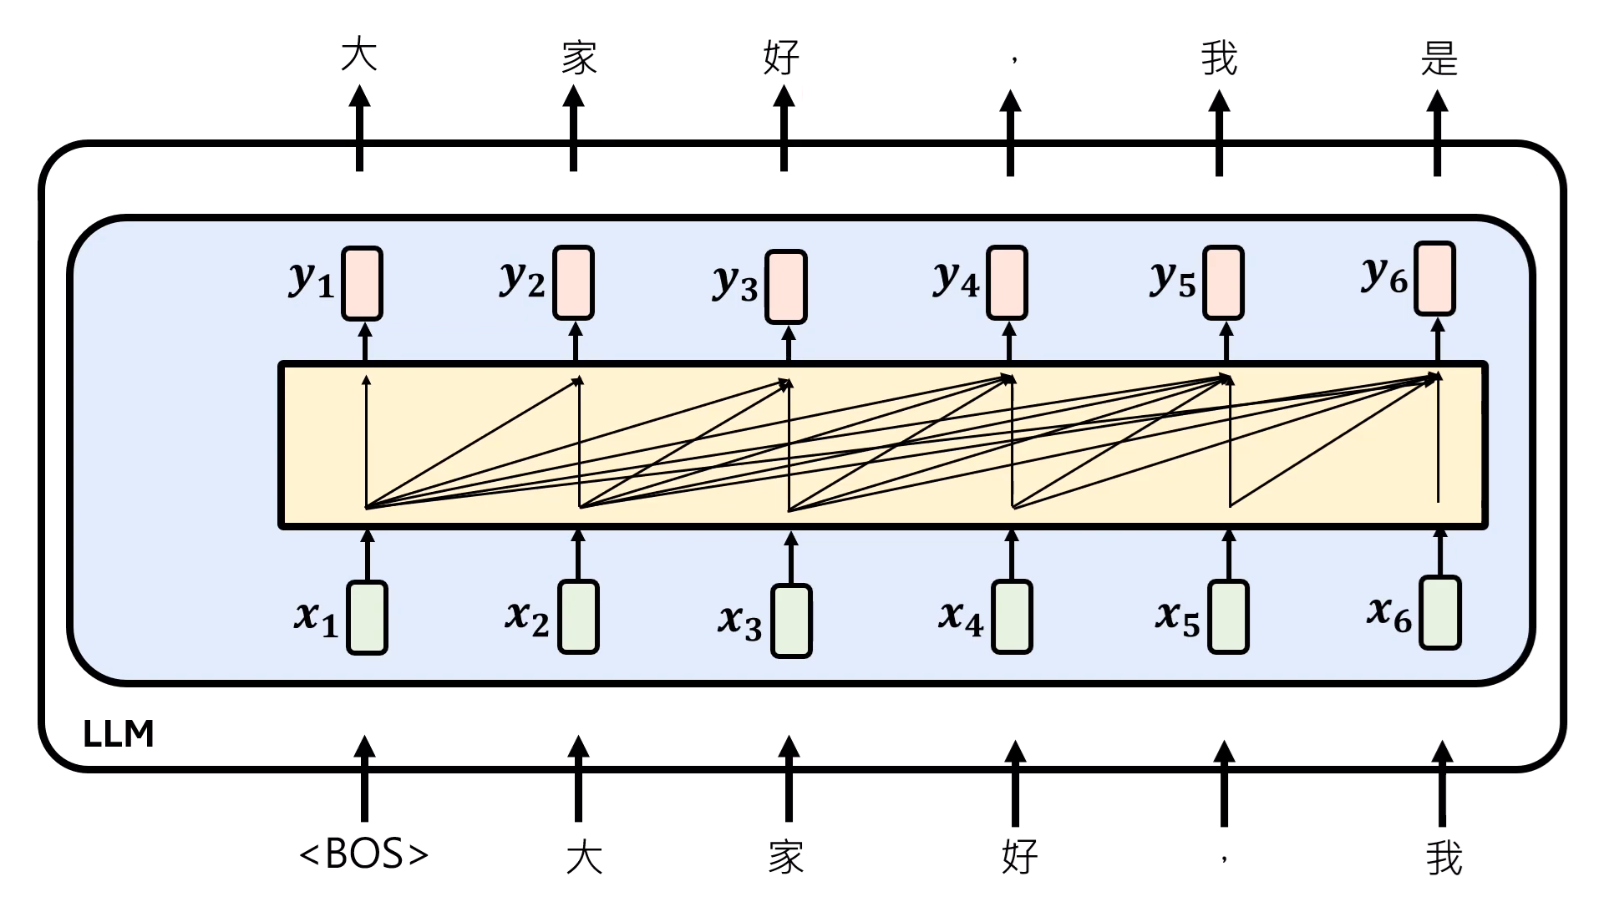
Sequence Models – Self Attention
Strengths: Training快(可以平行化)、看全局資訊
Weaknesses: Inference慢(計算量大)
https://youtu.be/gjsdVi90yQo

Slide 10
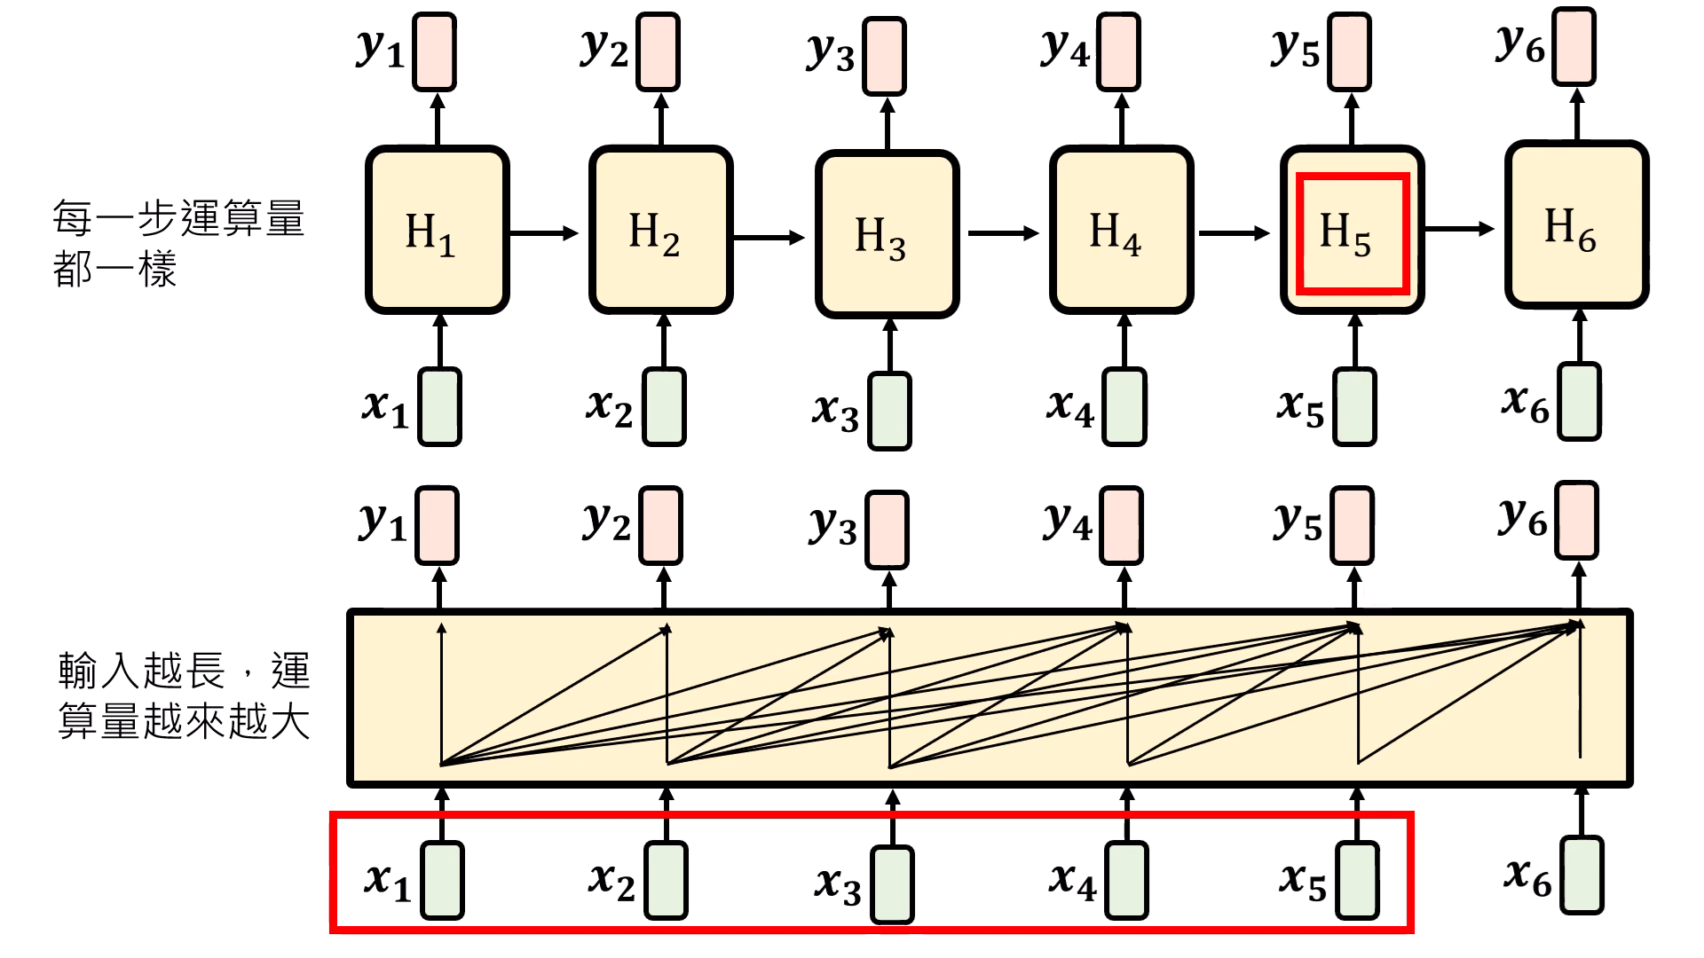
Sequence Models – RNN Styles vs. Self Attention
RNN Styles
Self Attention
https://youtu.be/gjsdVi90yQo

Slide 11
Sequence Models
 | Training Phase | Inference Phase | Information | Issue
RNN (1986) | slow | fast | rapid forgetting | 梯度爆炸/消失
LSTM (1997) | slow | fast | forgetting
Transformer (2017) | fast | slow | 全部考慮 | 二次問題
Notes:
quadratic scaling problem

Slide 12

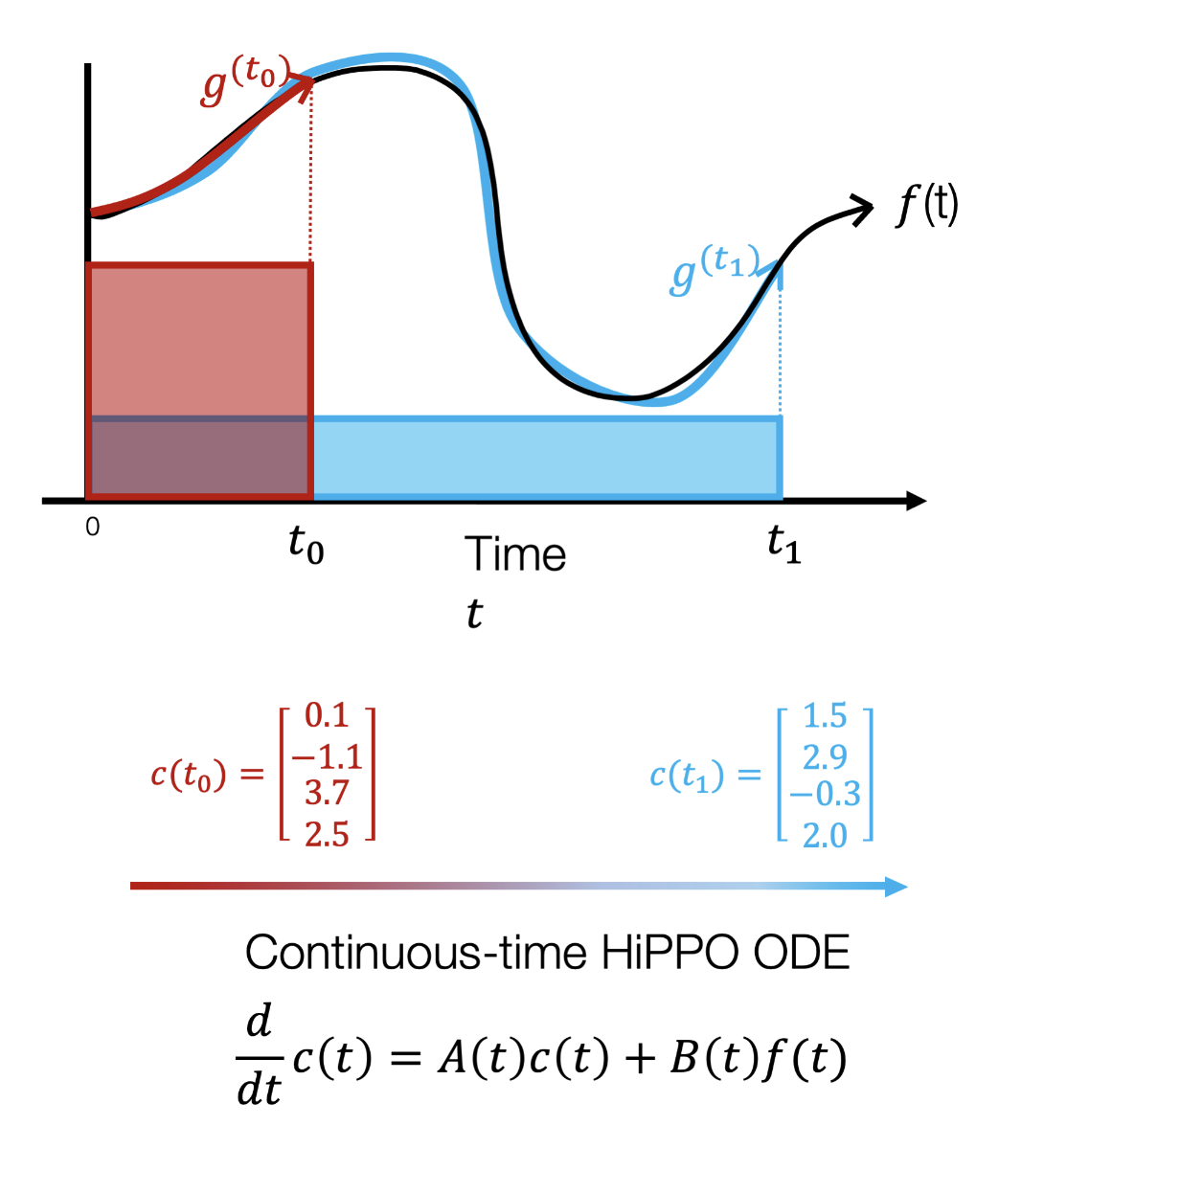
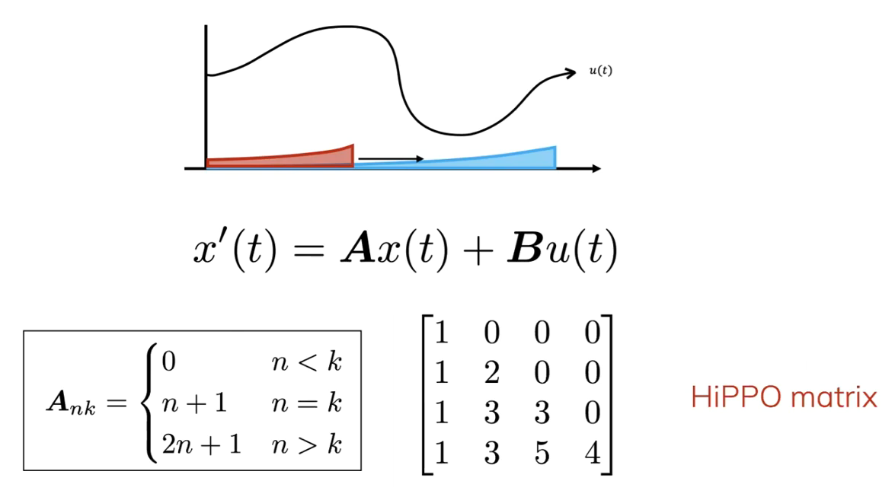
HiPPO: Recurrent Memory with Optimal Polynomial Projections
NIPS 2020, Albert Gu
核心問題:
將過去資訊壓縮成有限維度的狀態表示
作法:
基於Orthogonal Polynomials (Legendre polynomials)進行投影
建立了一個理論上最佳的記憶更新機制，HiPPO matrix
將coefficient vector的式子離散化
https://youtu.be/luCBXCErkCs
Notes:
如何在接收持續不斷的新資料時
將無限長的訊號，有效地壓縮並表示在一個有限維度的狀態之中

Slide 13
HiPPO: Recurrent Memory with Optimal Polynomial Projections
NIPS 2020, Albert Gu
核心問題:
將過去資訊壓縮成有限維度的狀態表示
作法:
基於Orthogonal Polynomials (Legendre polynomials)進行投影
建立了一個理論上最佳的記憶更新機制，HiPPO matrix
透過HiPPO matrix (N=64)紀錄資訊
https://youtu.be/luCBXCErkCs
Notes:
如何在接收持續不斷的新資料時
將無限長的訊號，有效地壓縮並表示在一個有限維度的狀態之中

Slide 14
HiPPO: Recurrent Memory with Optimal Polynomial Projections
NIPS 2020, Albert Gu
EMA
描述趨勢
EWMA
HiPPO
記錄歷史
https://youtu.be/luCBXCErkCs
Notes:
如何在接收持續不斷的新資料時
將無限長的訊號，有效地壓縮並表示在一個有限維度的狀態之中

Slide 15
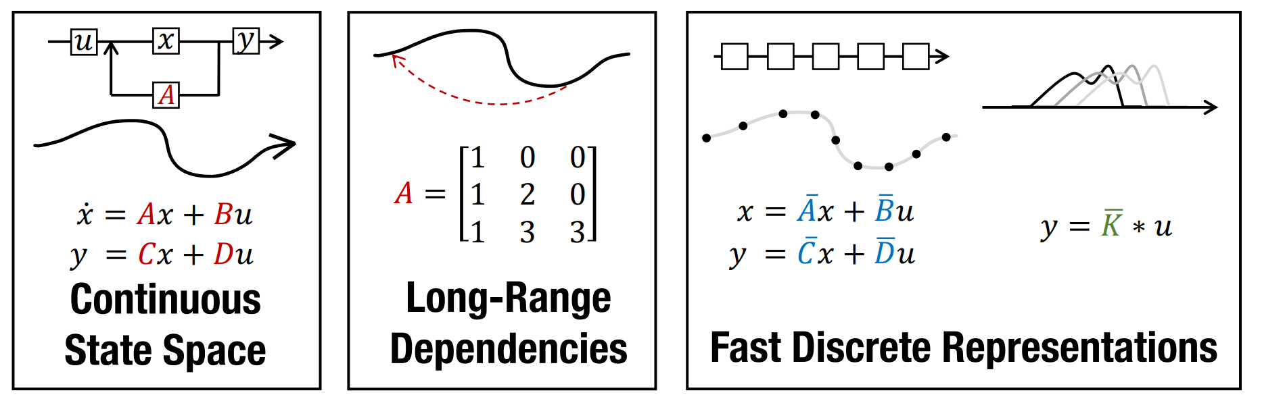
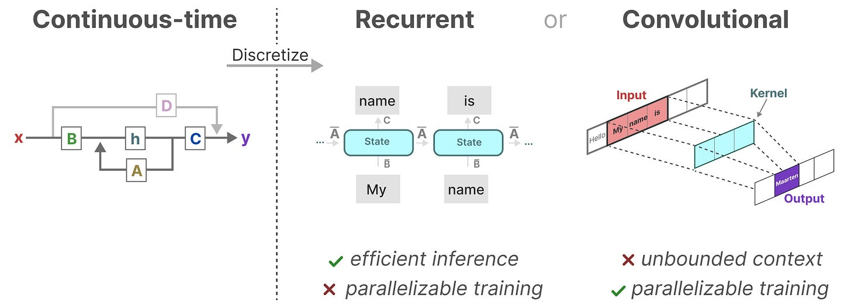
S4 Efficiently Modeling Long Sequences with Structured State Spaces
ICLR 2022, Albert Gu
重點
SSM
HiPPO
Efficiently computing

Slide 16
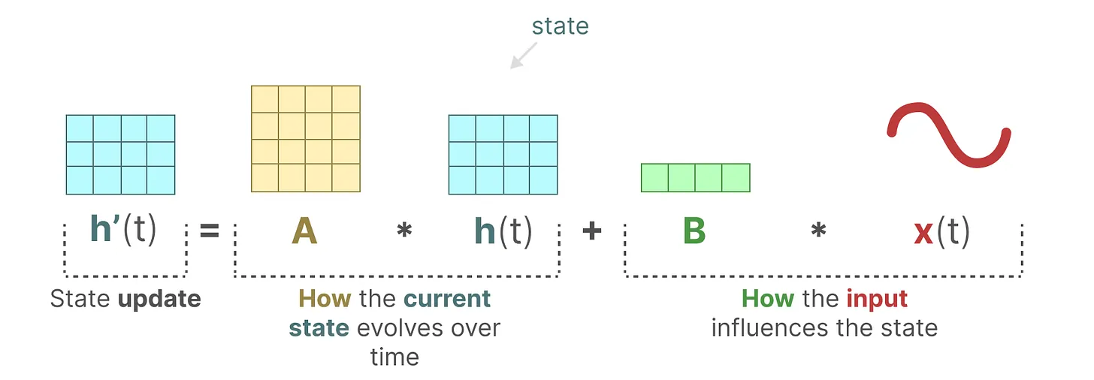
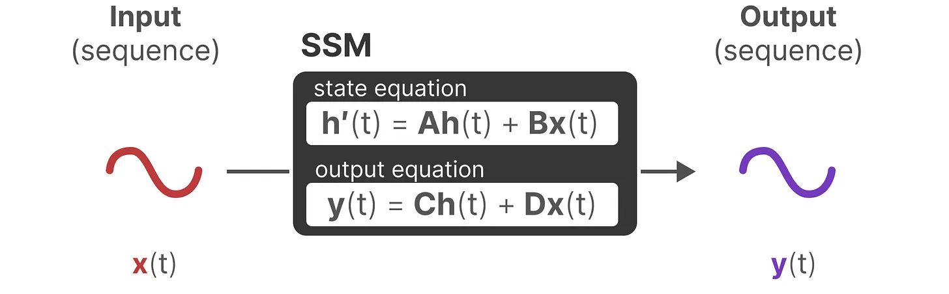
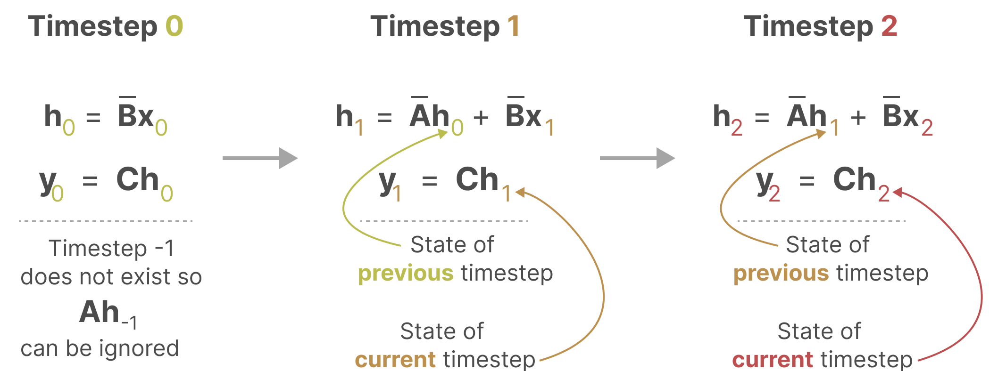
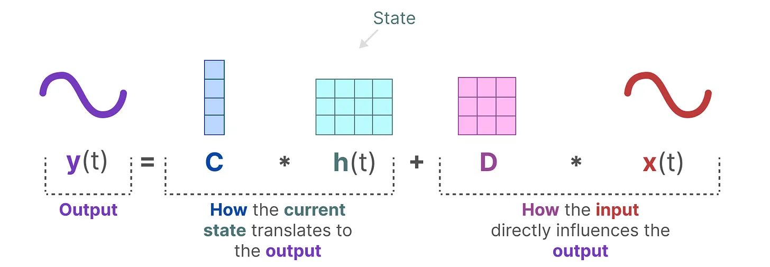
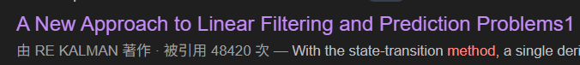

S4 Efficiently Modeling Long Sequences with Structured State Spaces
ICLR 2022, Albert Gu
與SSM (State Space Model)結合
A使用HiPPO管理記憶
B, C自己學

Slide 17
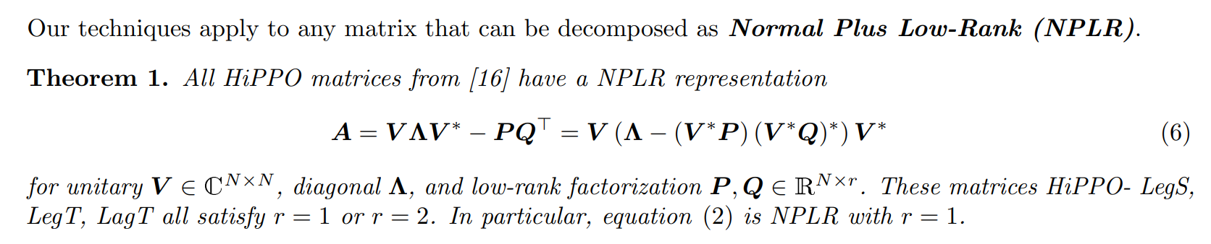
S4 Efficiently Modeling Long Sequences with Structured State Spaces
ICLR 2022, Albert Gu
HiPPO
降低HiPPO matrix計算量
V: unitary matrix (么正矩陣), is an orthogonal matrix

Slide 18
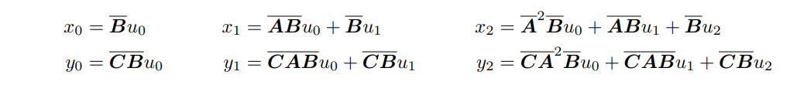
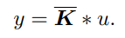
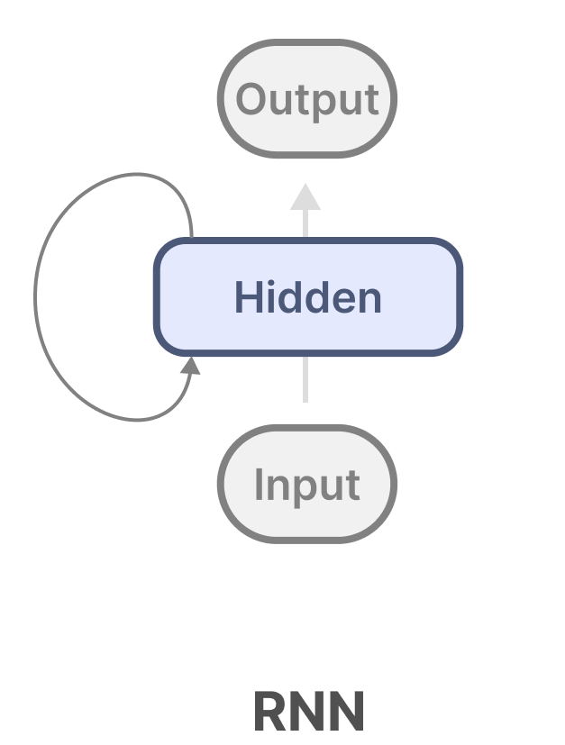
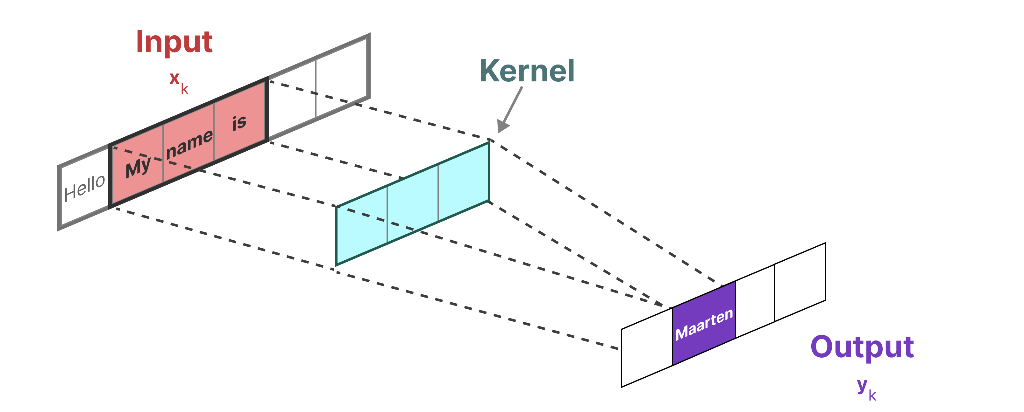
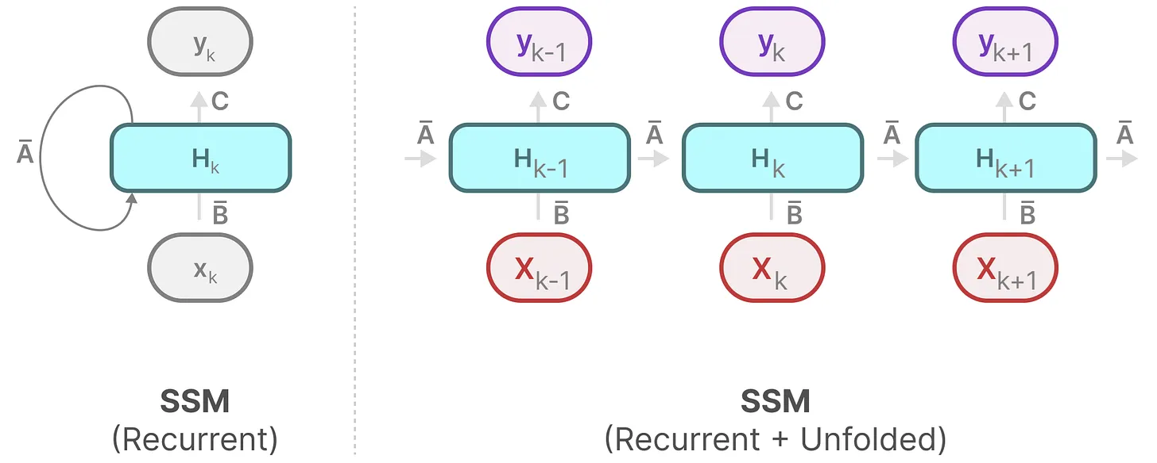
S4 Efficiently Modeling Long Sequences with Structured State Spaces
ICLR 2022, Albert Gu
Efficiently computing
像RNN一樣線性Inference
像CNN一樣平行Training
像RNN一樣線性Inference
像CNN一樣平行Training

Slide 19
S4 Efficiently Modeling Long Sequences with Structured State Spaces
 | Training Phase | Inference Phase | Information | Issue
RNN (1986) | slow | fast | rapid forgetting | 梯度爆炸/消失
LSTM (1997) | slow | fast | forgetting
Transformer (2017) | fast | slow | 全部考慮 | 二次問題
S4 (2021) | fast | fast | 壓縮全部 | 矩陣固定

Slide 20
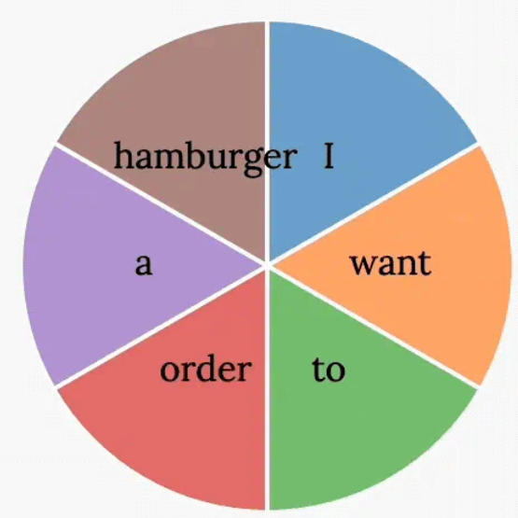
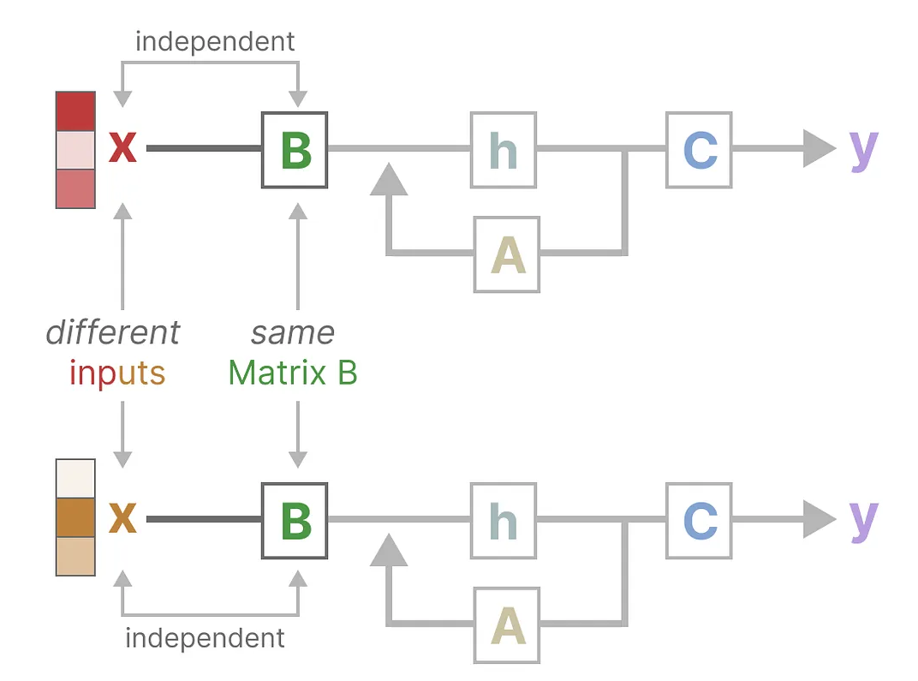
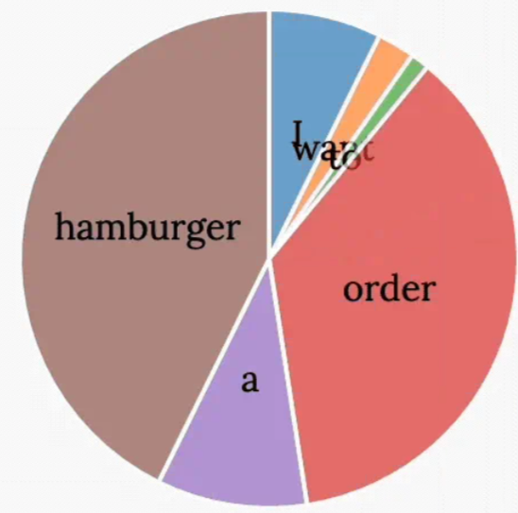
Mamba: Linear-Time Sequence Modeling with Selective State Spaces
S4的侷限性:
Linear Time Invariance (LTI)，SSM中A, B, C不隨輸入改變
缺乏內容感知能力
Hidden State
Bad
I want to order a hamburger
Good

Slide 21
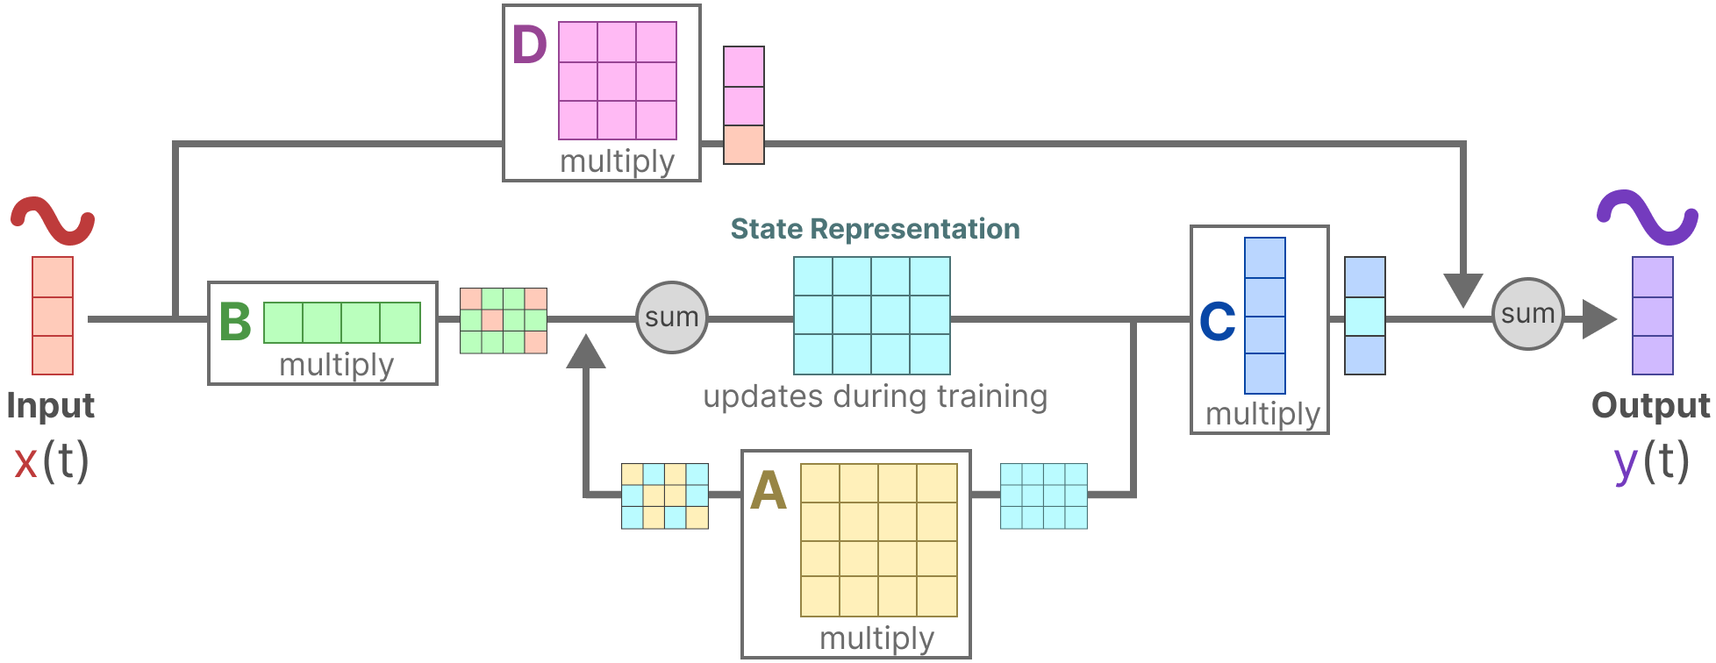
Mamba: Linear-Time Sequence Modeling with Selective State Spaces
S6: SSMs with Selection，讓模型參數依賴於輸入內容

Slide 22
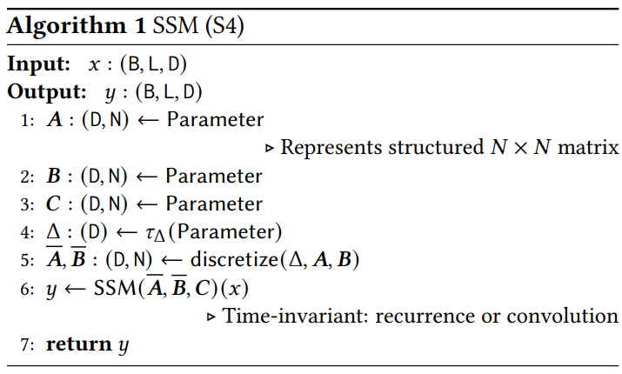
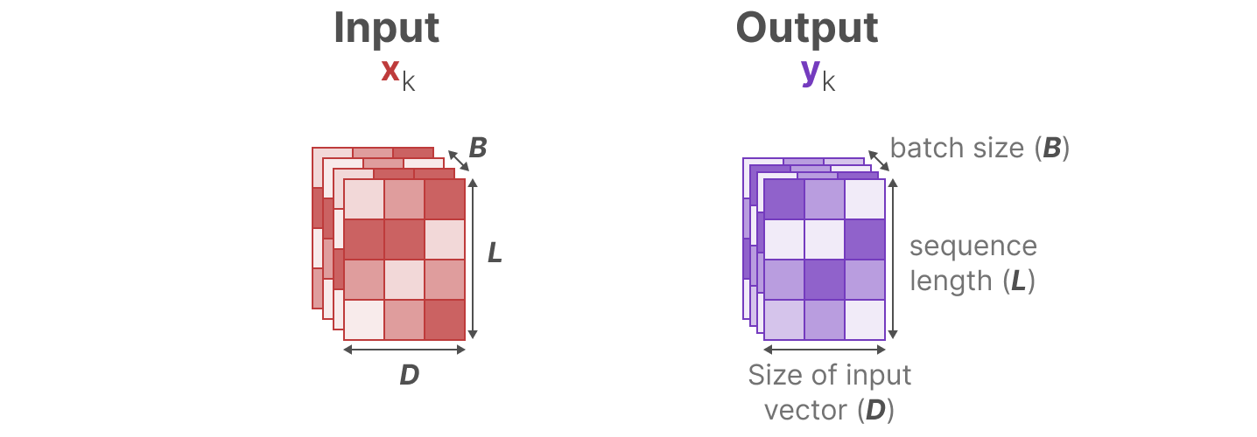

Slide 23
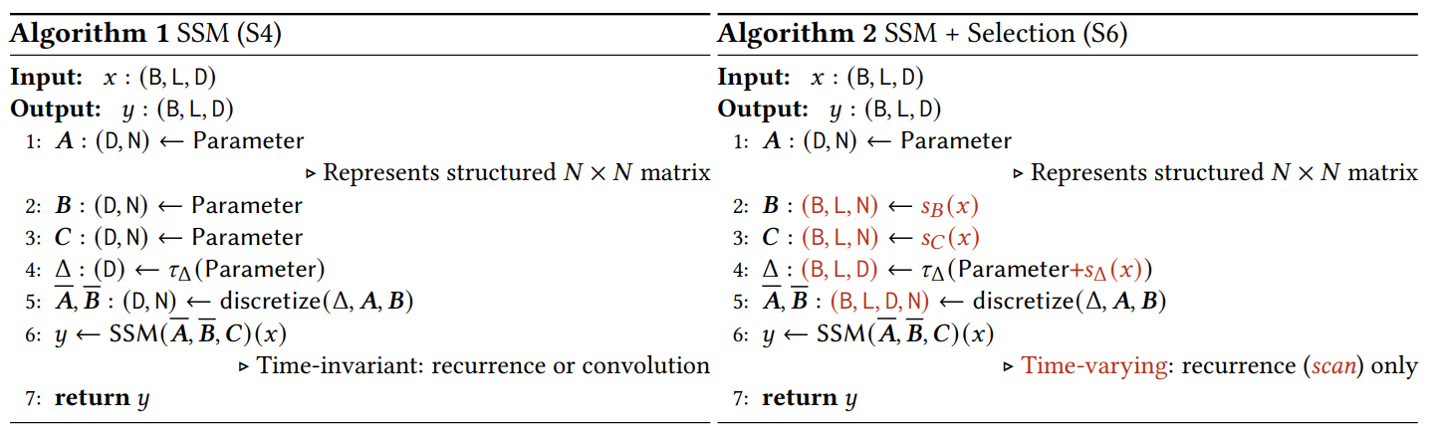
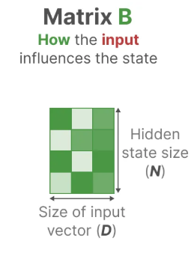
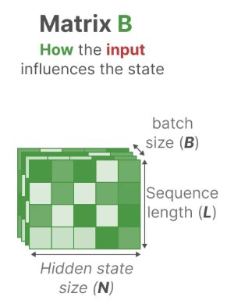
SSM被獨立地應用在D個dimension上

Slide 24
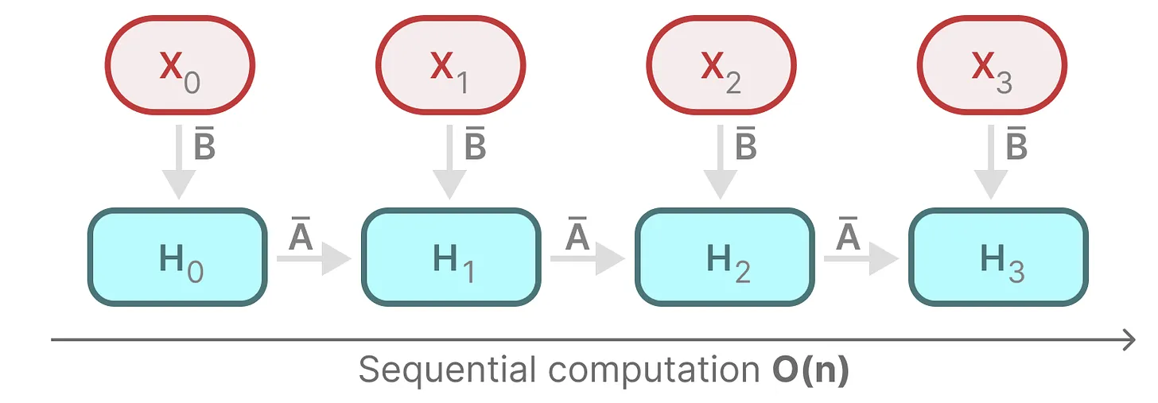
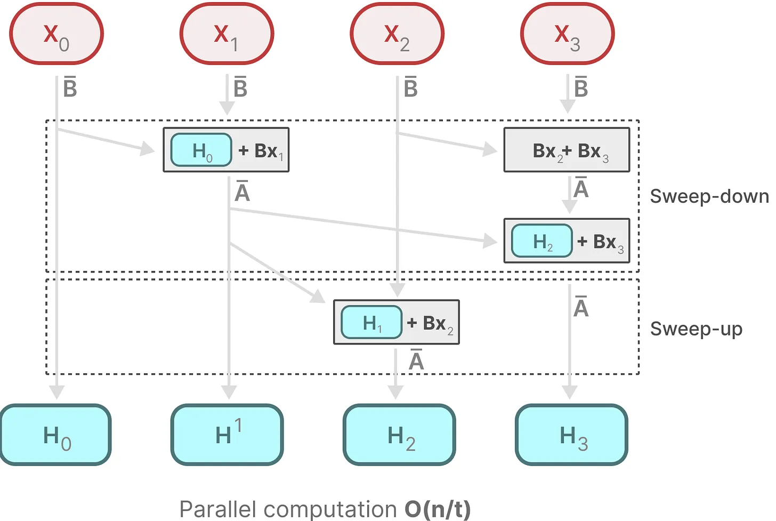
Mamba: Linear-Time Sequence Modeling with Selective State Spaces
Parallel Scan:
因A, B, C變動態的，不能以CNN的方式平行計算
透過Sweep-down、Sweep-up的方式達到並行效果

Slide 25
Mamba: Linear-Time Sequence Modeling with Selective State Spaces
 | Training Phase | Inference Phase | Information | Issue
RNN (1986) | slow | fast | rapid forgetting | 梯度爆炸/消失
LSTM (1997) | slow | fast | forgetting
Transformer (2017) | fast | slow | 全部考慮 | 二次問題
S4 (2021) | fast | fast | 壓縮全部 | 矩陣固定
Mamba (2023) | fast | fast | 選擇性關注

Slide 26
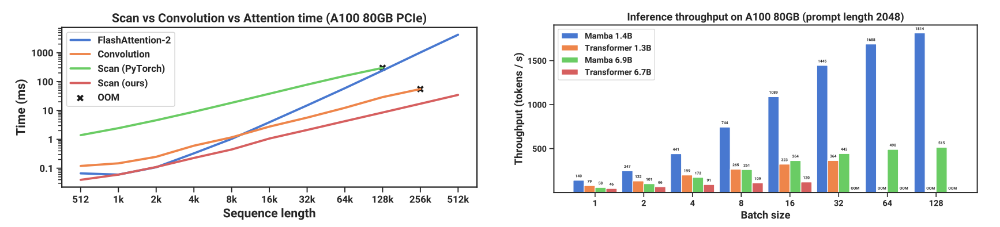
Performance – Speed and Memory
Parallel Scan:
40x Faster
5x higher throughput

Slide 27
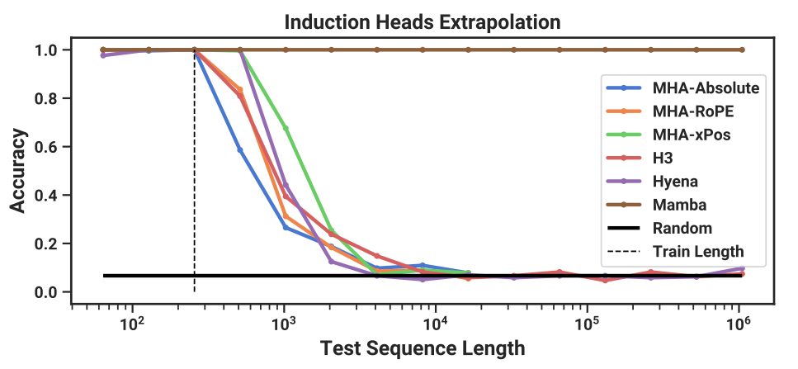
Performance – Induction Heads Extrapolation
Mamba has perfect generalization accuracy
Trained on 256 length

Slide 28
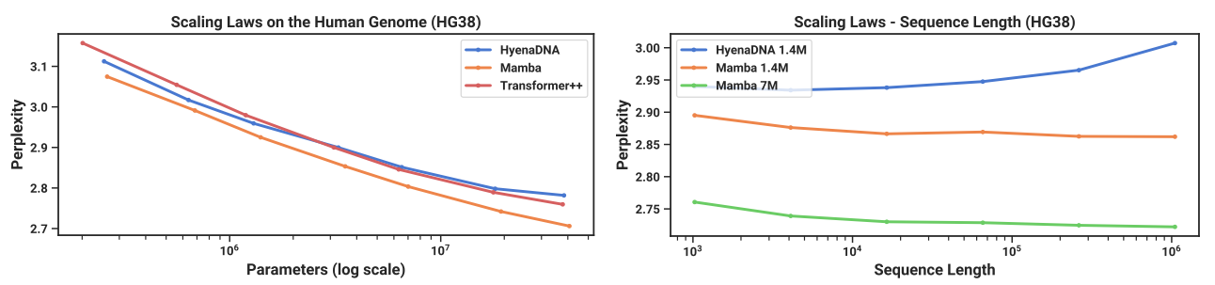
Performance – DNA Model
Mamba has better performance with increasing context length

Slide 29
Summary
Strengths:
在長序列方面表現優異
速度快、硬體需求小
Weaknesses:
生態不成熟、要達到最佳性能需依賴CUDA的優化
可解釋性較差
 | 核心問題 | 成果
HiPPO (2020) | 將過去資訊壓縮成有限維度的狀態表示 | 基於正交多項式的記憶更新機制
S4 (2021) | 如何應用HiPPO到深度學習中 | 透過SSM+HiPPO，高效處理長序列
Mamba (2023) | S4缺乏內容感知能力 | 引入選擇性機制，讓效能媲美Transformer
Mamba 2 (ICML 2024)
https://github.com/XiudingCai/Awesome-Mamba-Collection

Slide 30

小故事 – Mamba被ICLR拒絕
Mamba目前有4800次引用

